Slide 1
Discussion of analysis for HTT competitors and internal compounds
April 18, 2022
Group Meeting
Zhen, Dann, Catherine, Joon, Magnus, Jessica

Slide 2
TST11872 Study design
New data (4/02/22)
Compound | CRL HTRF IC50 (nM) | Internal HTRF IC50 (nM) | Internal iPSC qPCR IC50 (nM) | Internal NGN2 qPCR IC50 (nM) | ~3x IC50 Dose (nM) | Actual X-fold IC50 (iPSC) | Actual X-fold IC50 (NGN2) | ~10x IC50 Dose (nM) | Actual X-fold IC50 (iPSC) | Actual X-fold IC50 (NGN2) | Notes
BIO-1755497 | 121 | 4 | 10.75 | 3 | 12 | 1.12 | 4.00 | 40 | 3.72 | 13.33 | Branaplam
BIO-2006152 | 87 | 15 | 14.26 | 9.1 | 45 | 3.16 | 4.95 | 150 | 10.52 | 16.48 | ~PTC-518
BIO-2059811 | 87 | Expected <100nM | 101.5 | 65.19 | 261 | 2.57 | 4.00 | 870 | 8.57 | 13.35 | PTC different core
BIO-2135644 | 100 | Expected <100nM | 81.68 | 68.31 | 300 | 3.67 | 4.39 | 1000 | 12.24 | 14.64 | PTC different core
BIO-2136770 | 100 | Expected <100nM | 41 | 24.59 | 300 | 7.32 | 12.20 | 1000 | 24.39 | 40.67 | Close PTC518 analog
BIO-1949634 | 1500 | 6200 | 357.55 | 324.6 | 3000 | 8.39 | 9.24 | 10000 | 27.97 | 30.81 | Risdiplam
BIO-2060573 | 5780 | 670 | 298.2 | 271.5 | 3000 | 10.06 | 11.05 | 10000 | 33.53 | 36.83 | Internal lead/different core
BIO-2070692 | 560 | 50 | 140.4 | 104.4 | 1680 | 11.97 | 16.09 | 5600 | 39.89 | 53.64 | Remix example
BIO-2060884 | 370 | 240 | 77.9 | 105.9 | 3700 | 47.50 | 34.94 | 10000 | 128.37 | 94.43 | Internal lead
DMSO | - | - | - | - | - | - |  | -
Strategies for comparison:
Comp1: NGN2 ~4x
BIO-1755497 (Bran) NGN2, Low (4x)
BIO-2006152 (PTC-518) NGN2, Low (5x)
BIO-2059811 (PTC) NGN2, Low (4x)
BIO-2135644 (PTC) NGN2, Low (4.4x)
Catherine
Comp2: NGN2 ~9-16x
BIO-1755497 (Bran) NGN2, High (13x)
BIO-2006152 (PTC-518) NGN2, High (16.5x)
BIO-2059811 (PTC) NGN2, High (13.3x)
BIO-2135644 (PTC) NGN2, High (14.5x)
BIO-2136770 (PTC) NGN2, Low (12x)
BIO-1949634 (Ris) NGN2, Low (9x)
BIO-2060573 (Internal) NGN2, Low (11x)
BIO-2070692 (Remix) NGN2, Low (16x)
Comp3: iPSC ~7-10x
BIO-2006152 (PTC-518) iPSC, High (10x)
BIO-2059811 (PTC) iPSC, High (8.5x)
BIO-2135644 (PTC) iPSC, High (12.2x)
BIO-2136770 (PTC) iPSC, Low (7x)
BIO-1949634 (Ris) iPSC, Low (9x)
BIO-2060573 (Internal) iPSC, Low (10x)
BIO-2070692 (Remix) iPSC, Low (12x)
Comp4: iPSC ~2-4x
BIO-1755497 (Bran) iPSC, High (4x)
BIO-2006152 (PTC-518) iPSC, Low (3x)
BIO-2059811 (PTC) iPSC, Low (2.6x)
BIO-2135644 (PTC) iPSC, Low (4x)

Slide 3
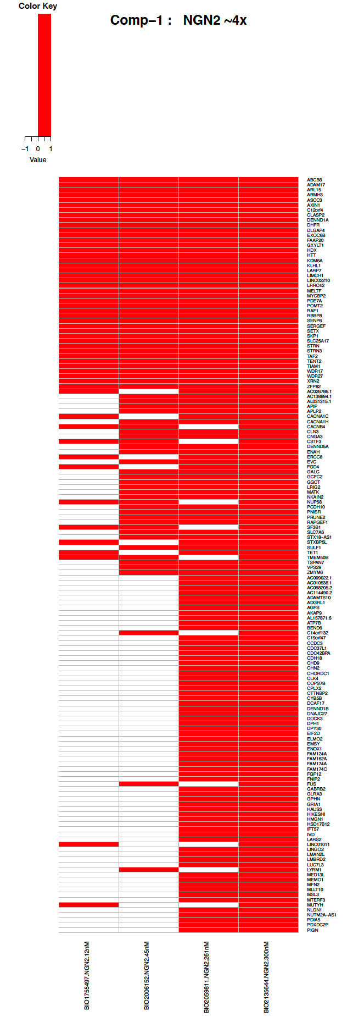
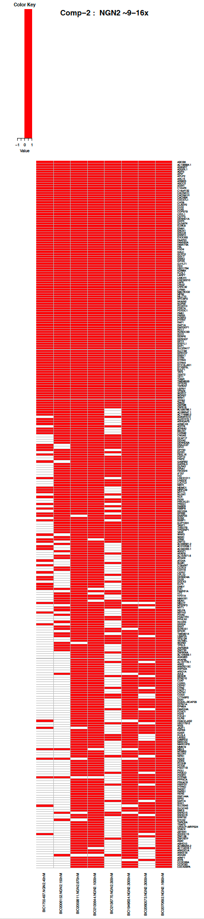
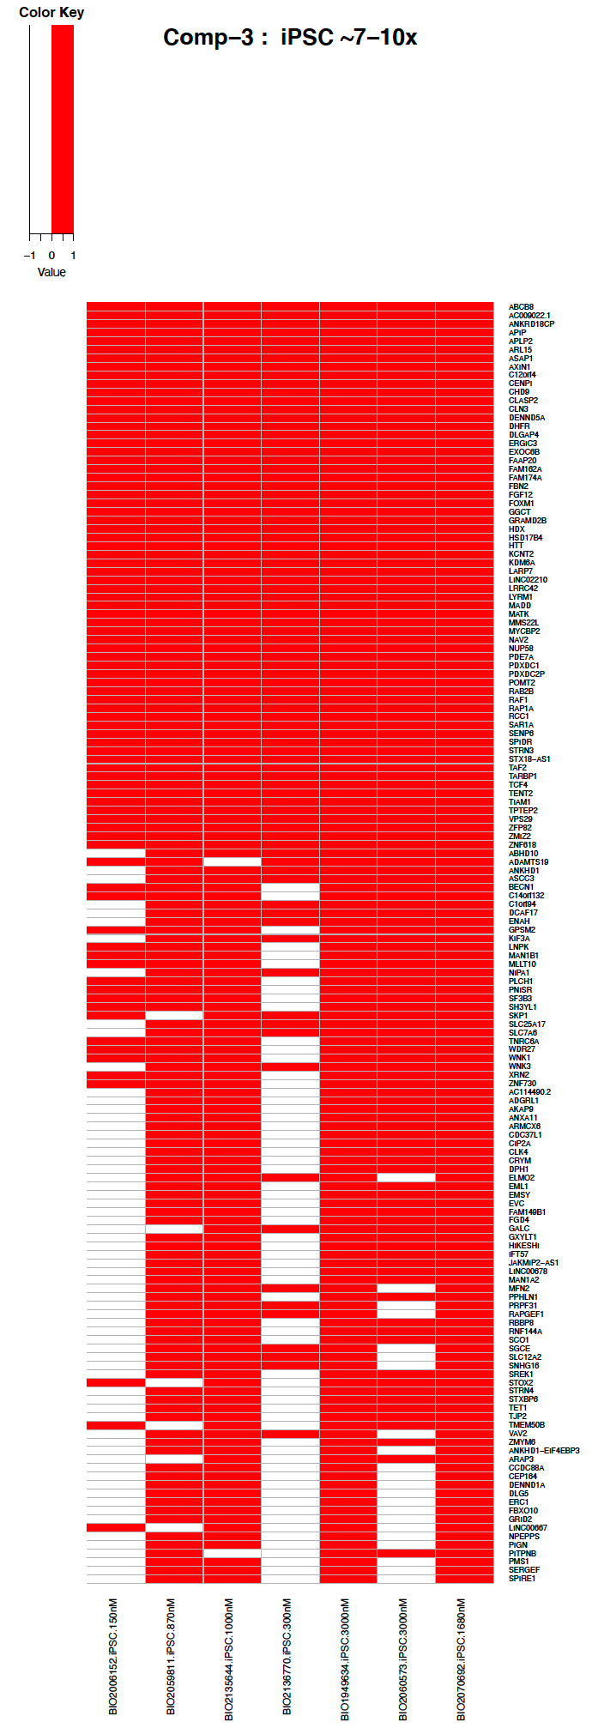
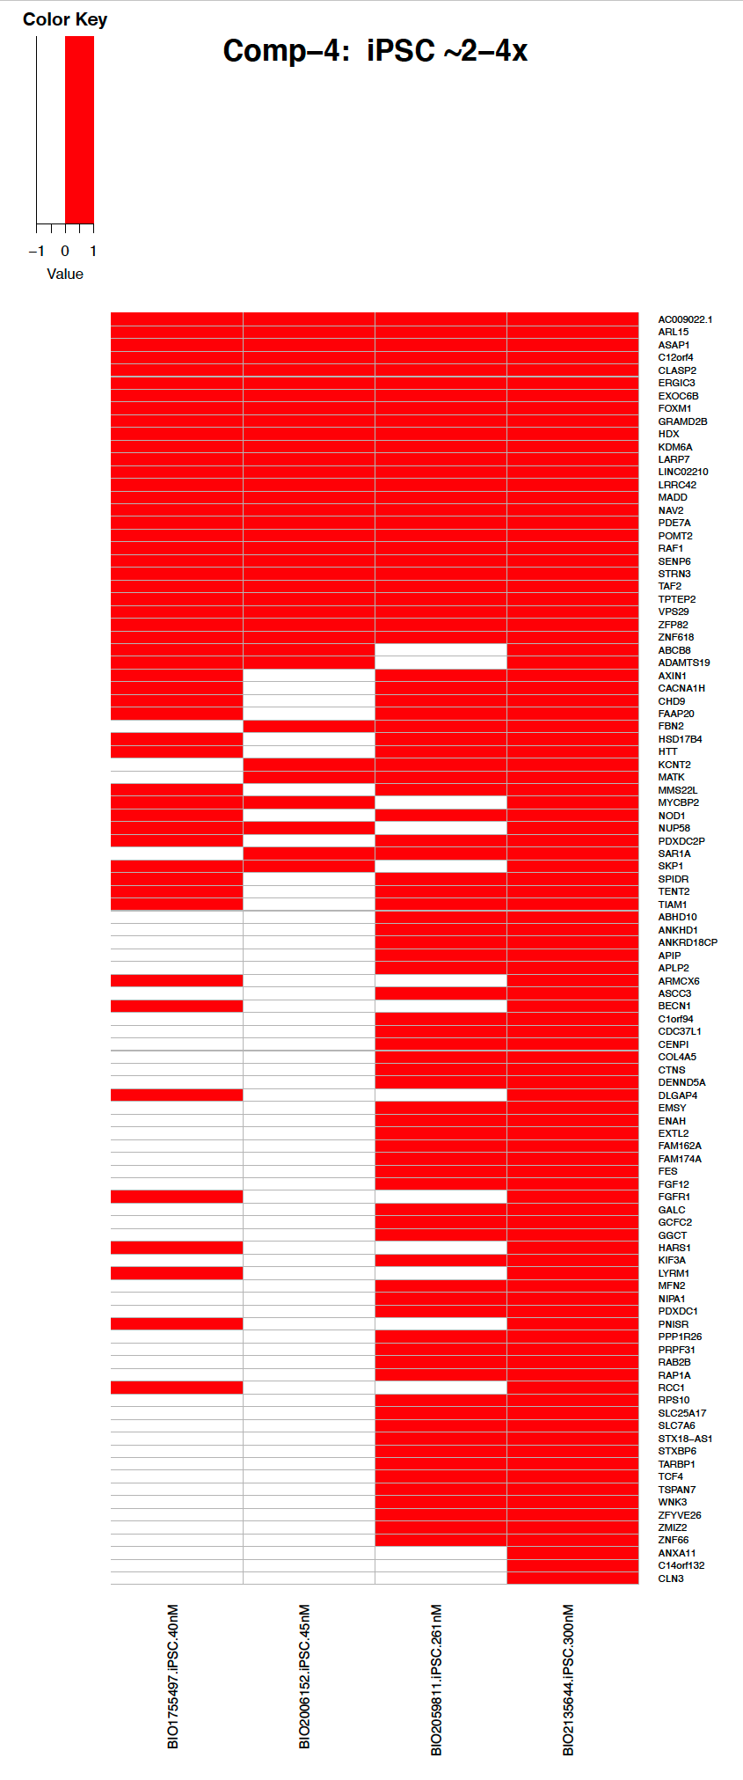
Branaplam and PTC518 benchmark RNA-seq data analysis

Slide 4
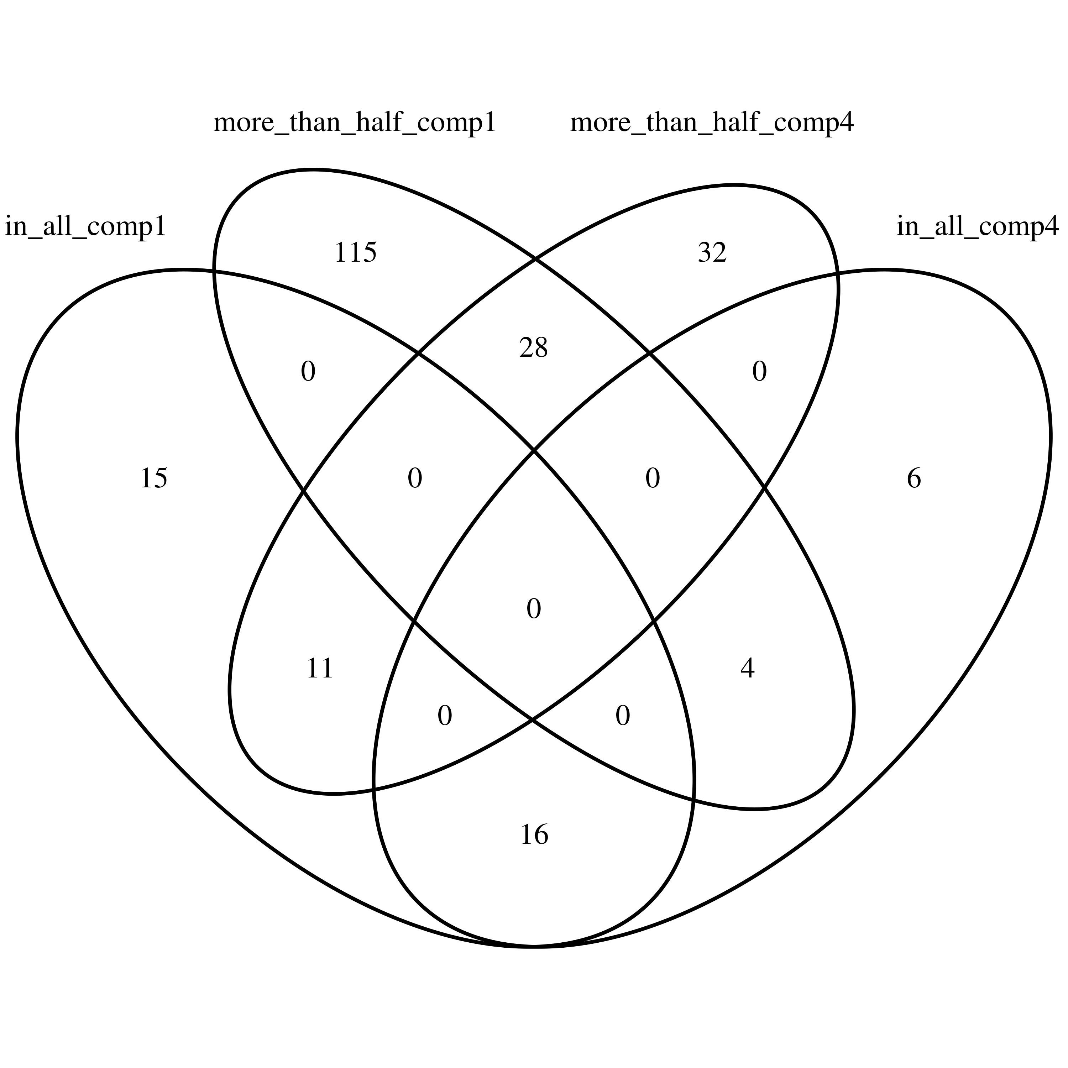
Venn Diagram

Slide 5
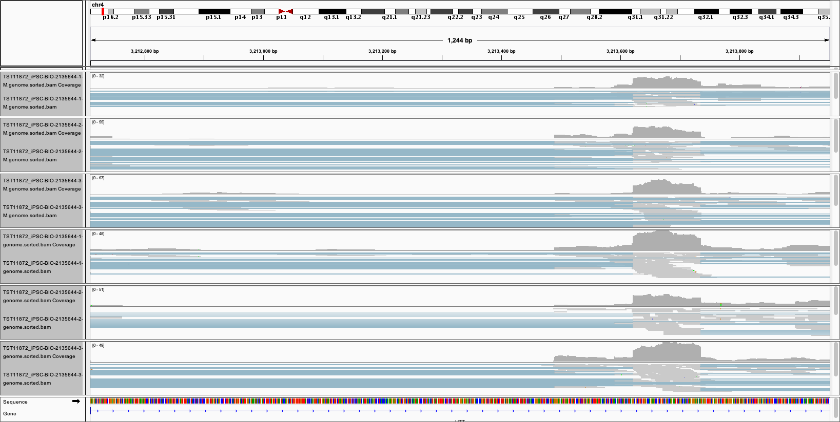
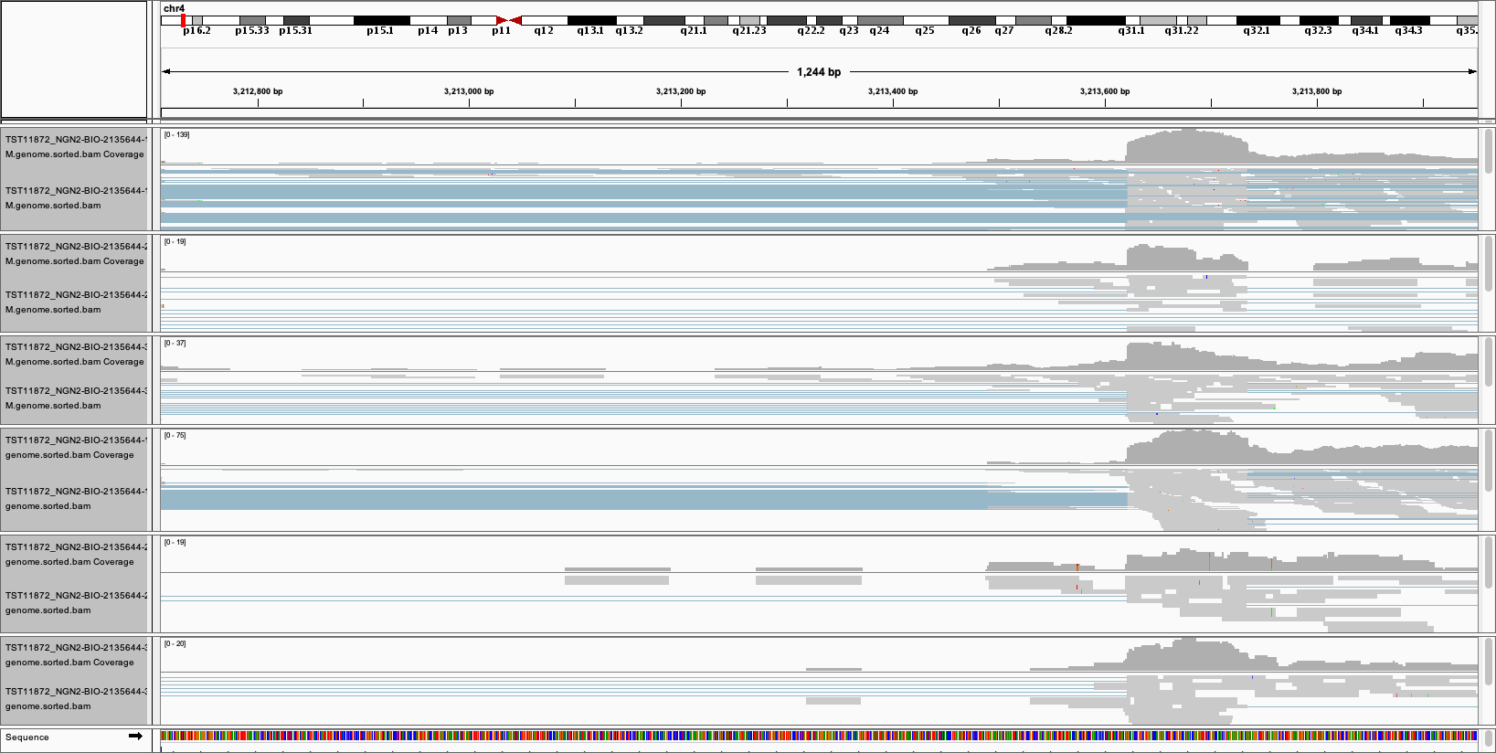
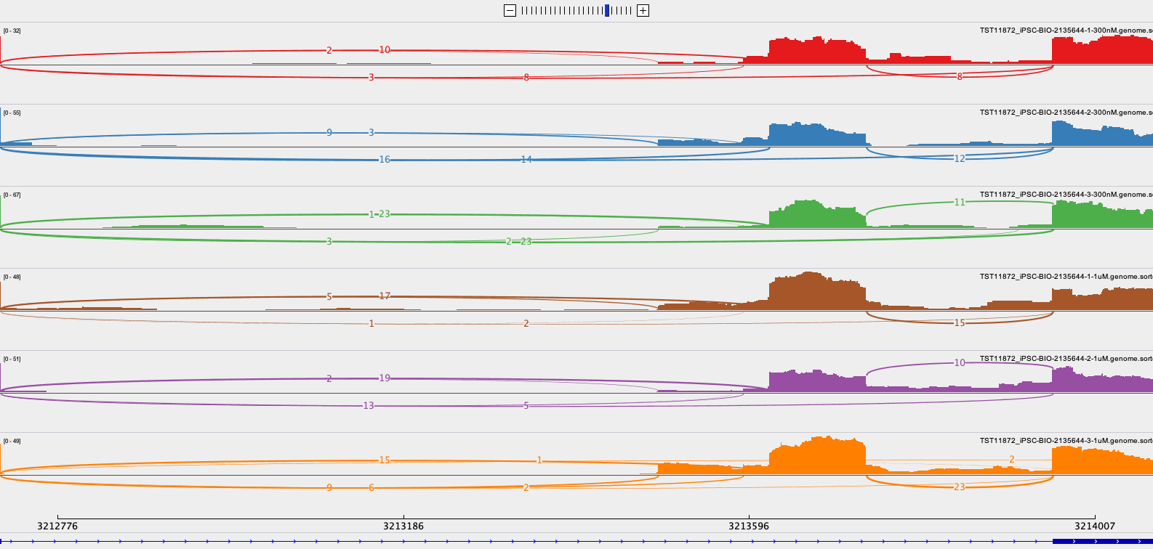
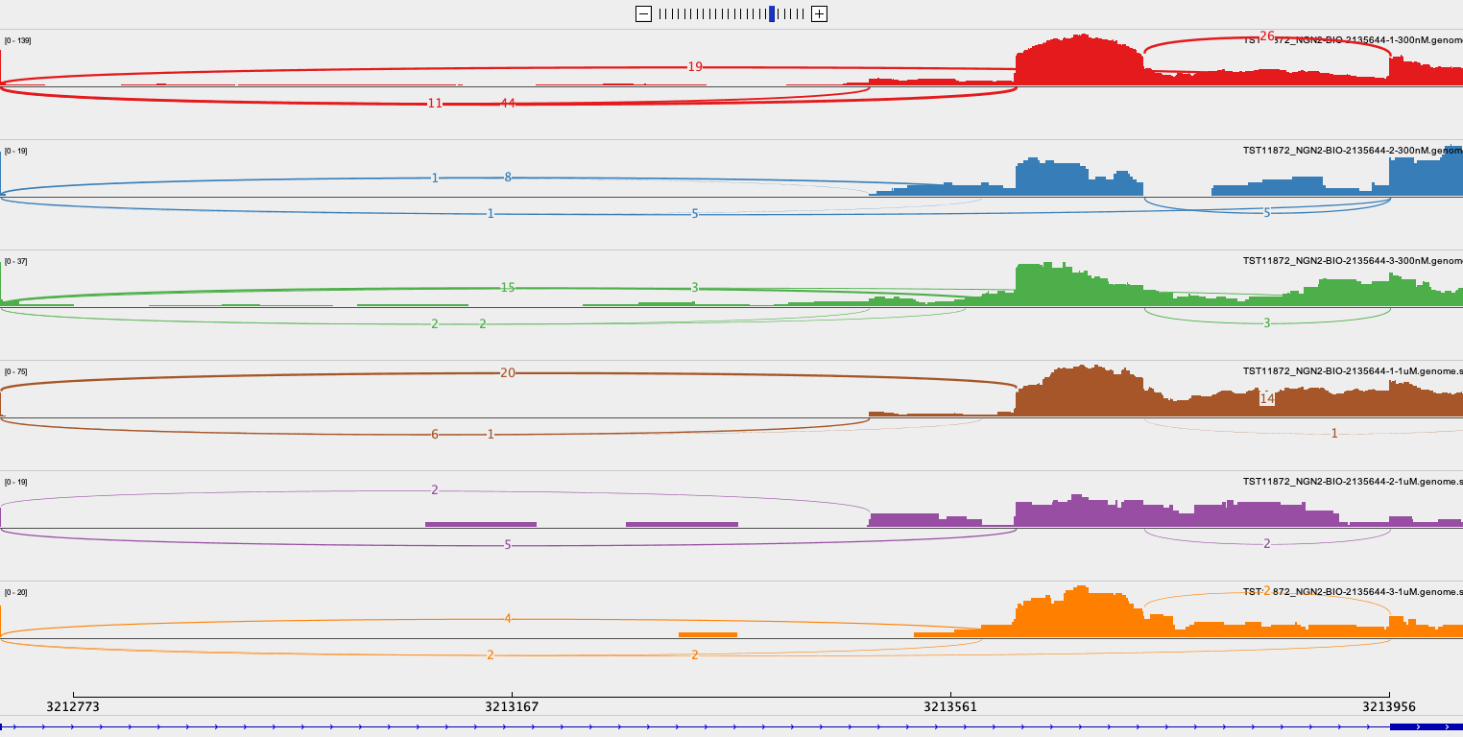
2135644 in iPSC and NGN2

Slide 6
2136770 (1000nM) in iPSC(Left) and NGN2(Right)

Slide 7
It looks more than toxic exon spicing in
Classical toxic exon splicing in type
48
49
49N
50
51
Ex49N: chr4:3,213,622-3,213,736 (+)
Non-Classical but high frequent ones
48
49
49N
Intron
50
51
Non-Classical and less frequent ones
48
49
49N
Intron
50
51
Nonsense-mediated mRNA decay (NMD)
Edited from Jessica Plots

Slide 8
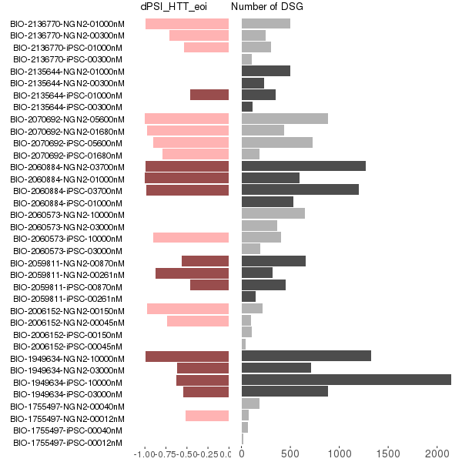
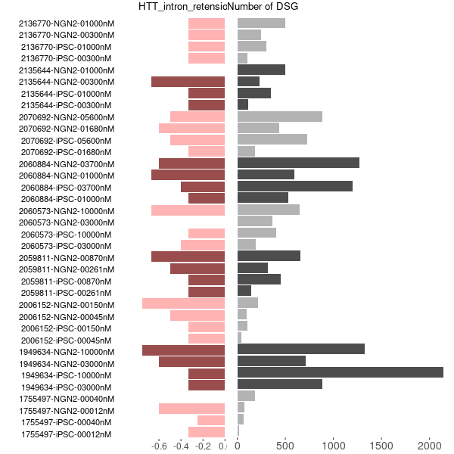
DSG and dPSI in eoi
dPSI from leafcutter
Intron_retension_rate (from majiq)

Slide 9


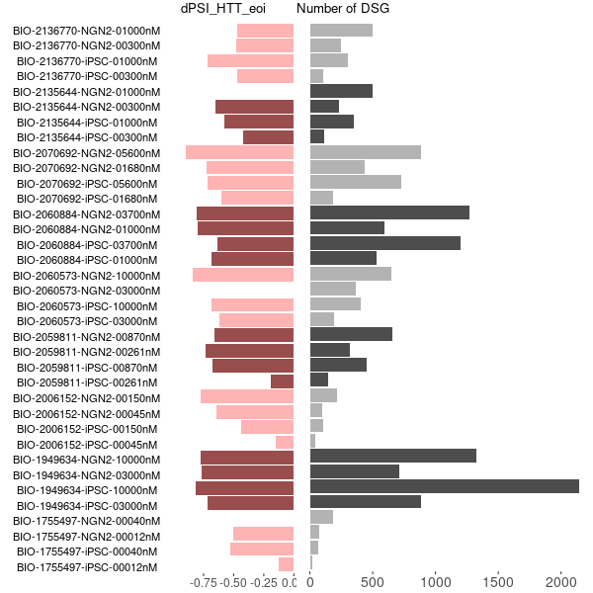
dPSI_of_eoi
dPSI
leafcutter-default
leafcutter-with-all-toxic-exon-forms
majiq-with-all-toxic-exon-forms

Slide 10
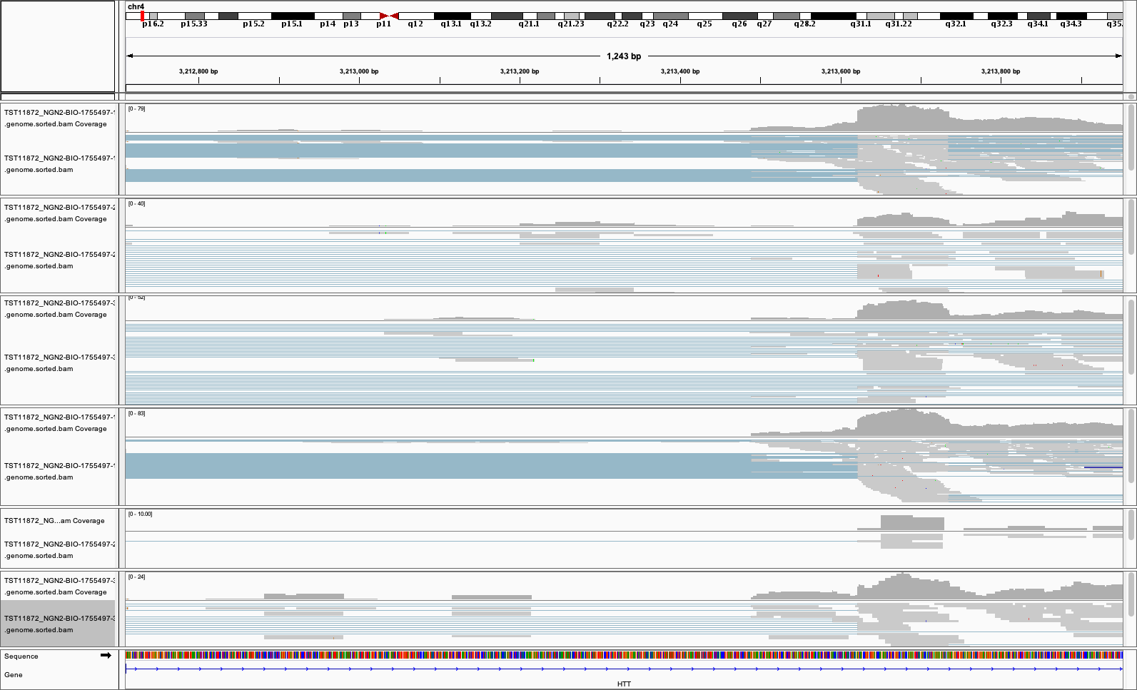
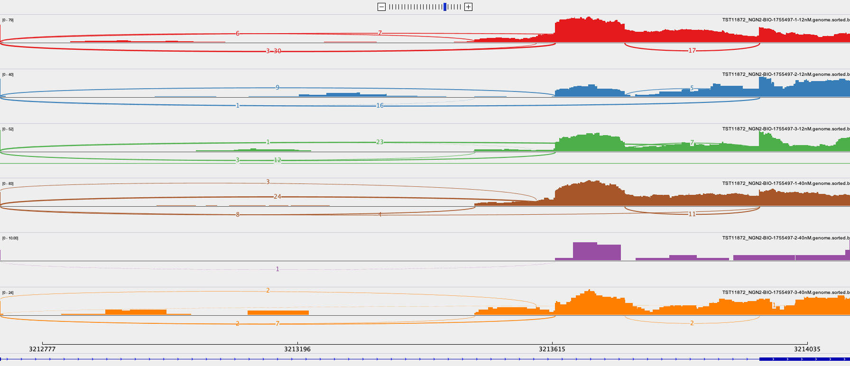
1755497 in NGN2

Slide 11
The motif analysis of selected regions

Slide 12
The selected region

